Slide 1
Networkx
Escherichia Coli & Homo Sapiens & Mus Musculus

Slide 2
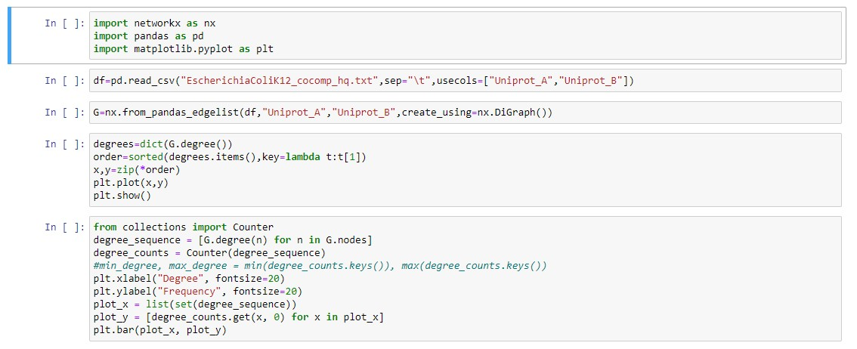
Code 1#

Slide 3
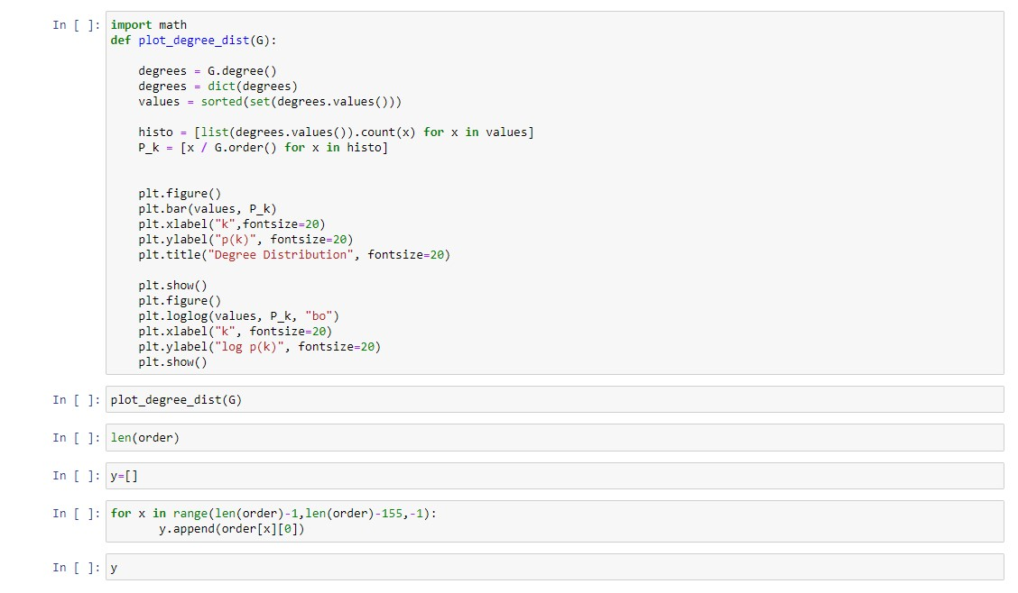
Code 2#

Slide 4
Escherichia Coli

Slide 5
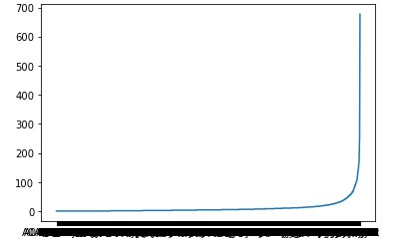
Escherichia Coli 1# Degrees Plot

Slide 6
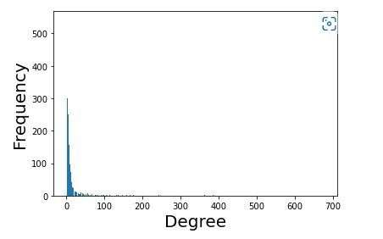
Escherichia Coli 2# Degrees Count Plot

Slide 7
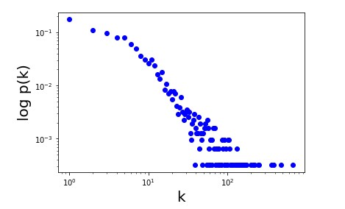
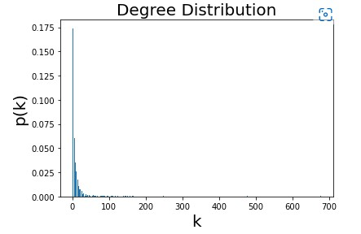
Escherichia Coli 3# Degrees Distribution Plots

Slide 8
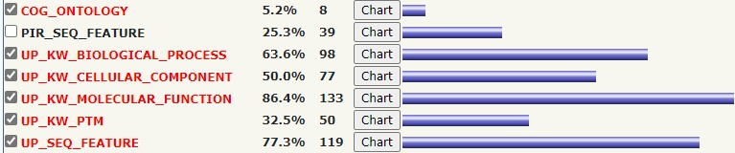
Escherichia Coli 4# Functional Annotations

Slide 9
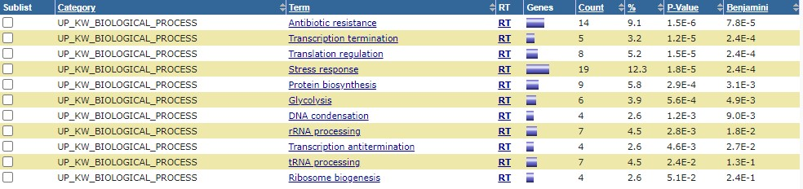
Escherichia Coli 4# Functional Annotations (Cont.) COG_ONTOLOGY & UP_KW_BIOLOGICAL_PROCES

Slide 10
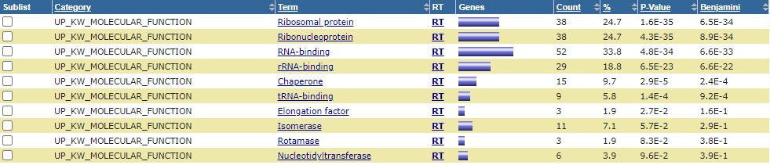
Escherichia Coli 4# Functional Annotations (Cont.) UP_KW_CELLULAR_COMPONENT & UP_KW_MOLECULAR_FUNCTION

Slide 11
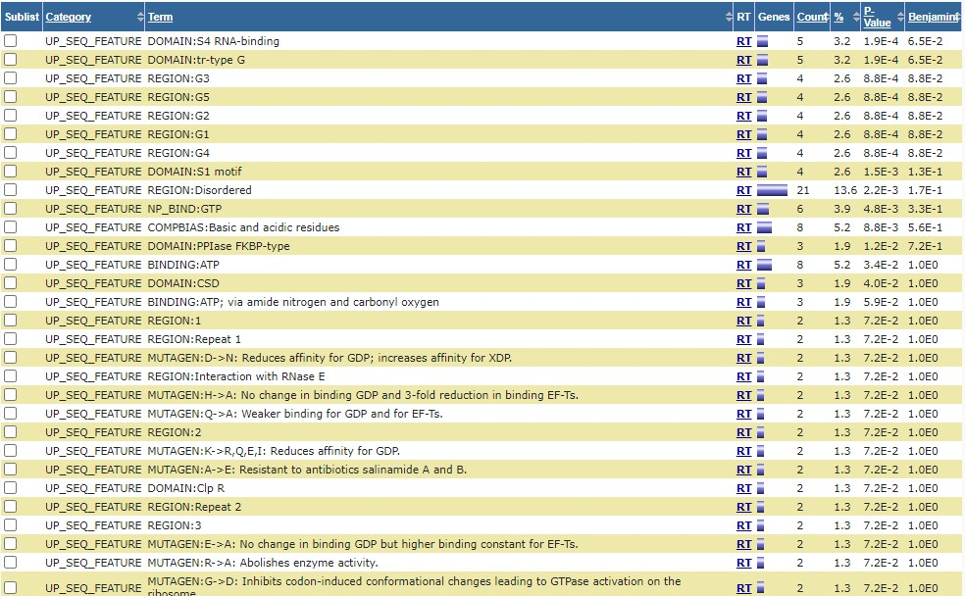
Escherichia Coli 4# Functional Annotations (Cont.) UP_KW_PTM & UP_SEQ_FEATURE

Slide 12
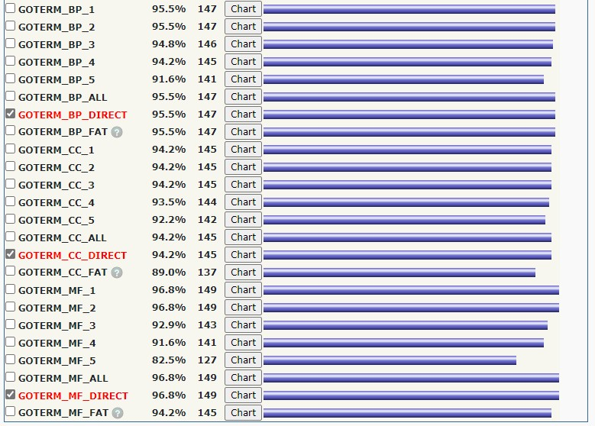
Escherichia Coli 5# Gene Ontology

Slide 13
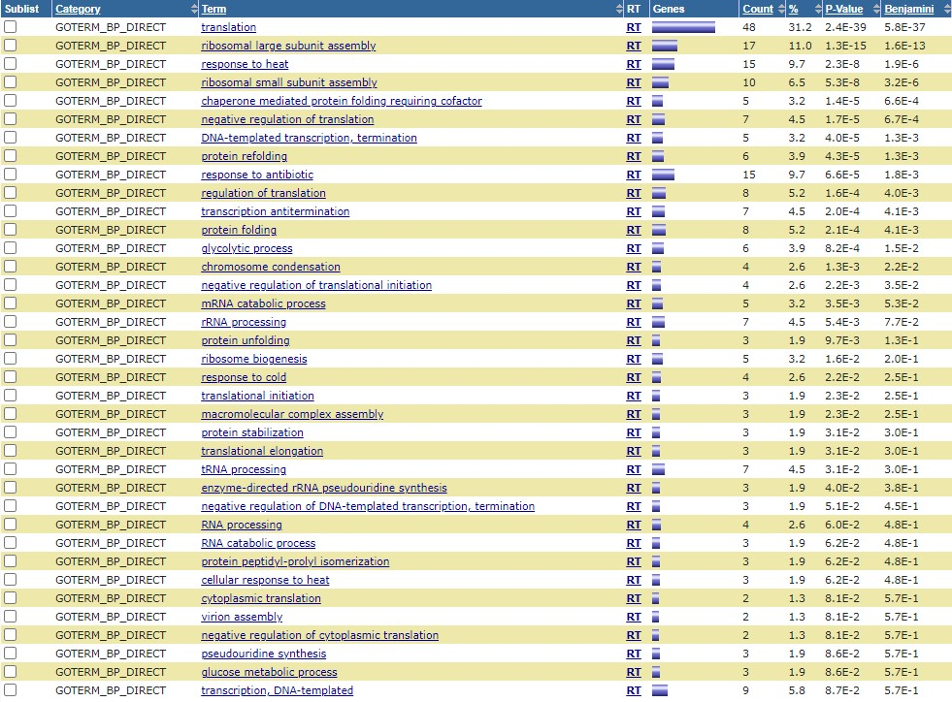
Escherichia Coli 5# Gene Ontology (Cont.) GOTERM_BP_DIRECT

Slide 14
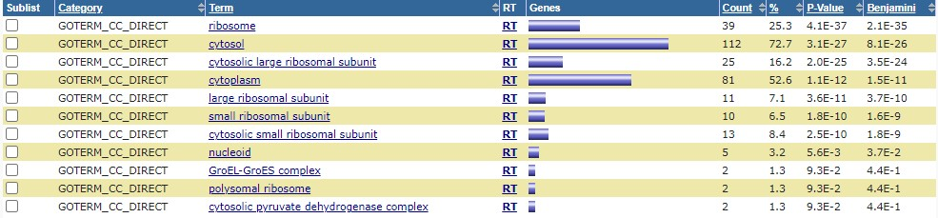
Escherichia Coli 5# Gene Ontology (Cont.) GOTERM_CC_DIRECT

Slide 15
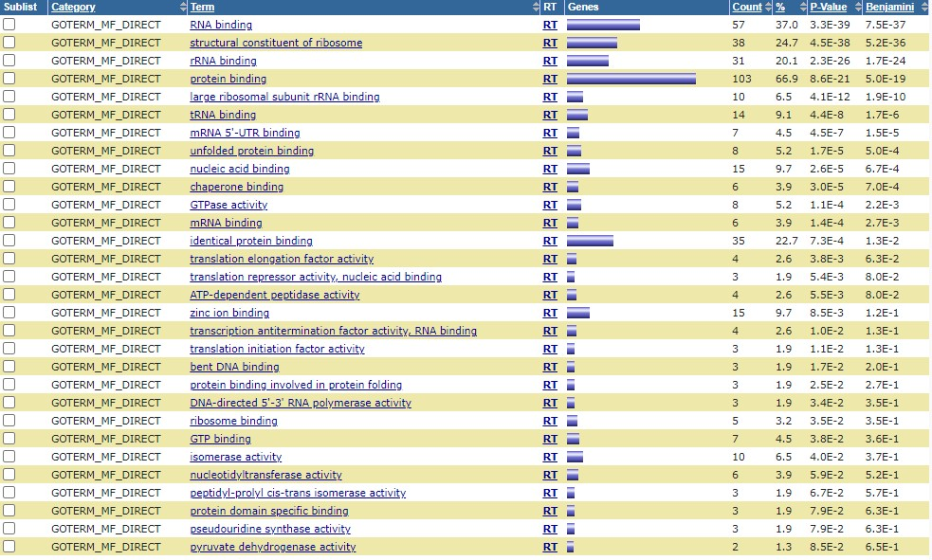
Escherichia Coli 5# Gene Ontology (Cont.) GOTERM_MF_DIRECT

Slide 16
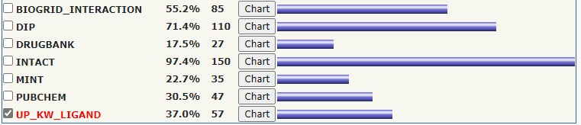
Escherichia Coli 6# Interactions (Cont.)

Slide 17
Escherichia Coli 6# Interactions (Cont.) UP_KW_LIGAND

Slide 18
Escherichia Coli 7# Pathways

Slide 19
Escherichia Coli 7# Pathways (Cont.) KEGG_PATHWAY

Slide 20
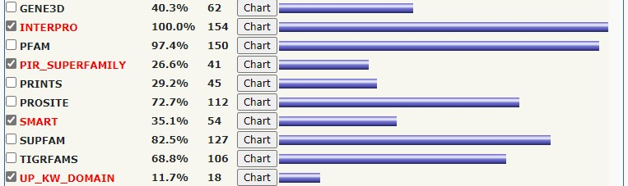
Escherichia Coli 8# Protein Domains

Slide 21
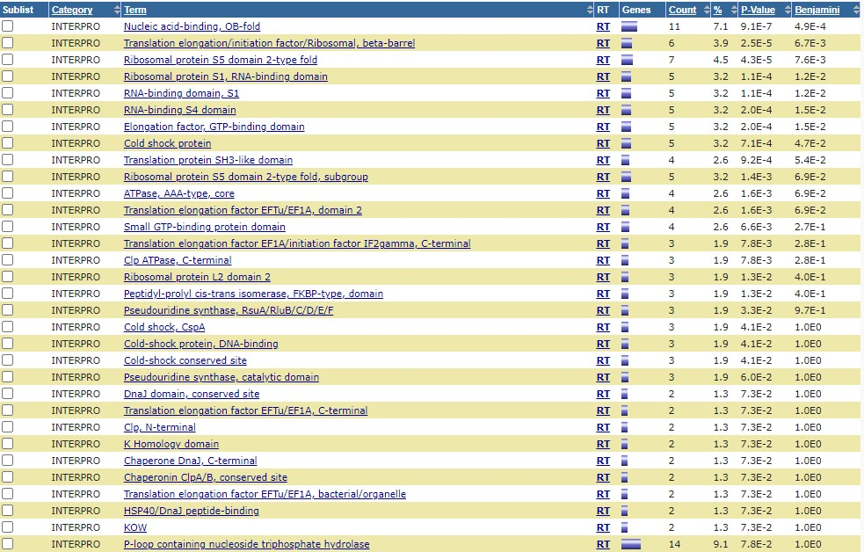
Escherichia Coli 8# Protein Domains (Cont.) INTERPRO

Slide 22
Escherichia Coli 8# Protein Domains (Cont.) PIR_SUPERFAMILY & Smart & UP_KW_DOMAIN

Slide 23
Homo Sapiens

Slide 24
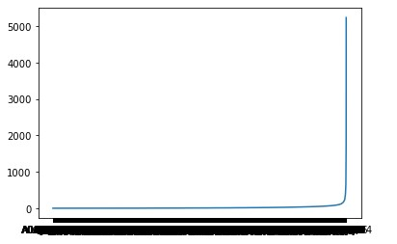
Homo Sapiens 1# Degrees Plot

Slide 25
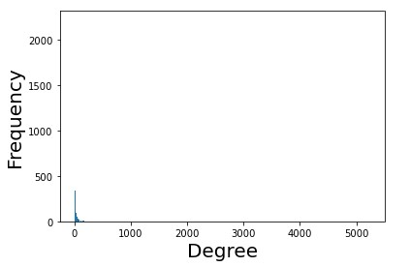
Homo Sapiens 2# Degrees Count Plot

Slide 26
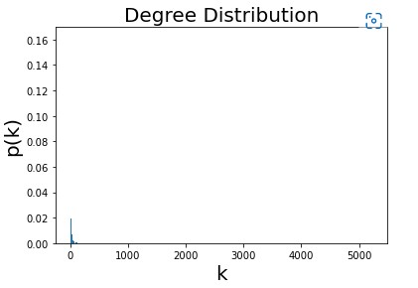
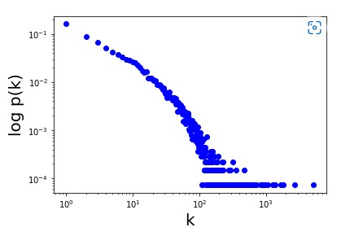
Homo Sapiens 3# Degrees Distribution Plots

Slide 27
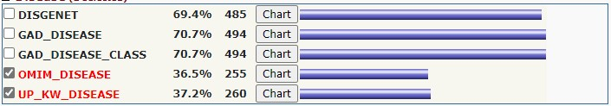
Homo Sapiens 4# Disease

Slide 28
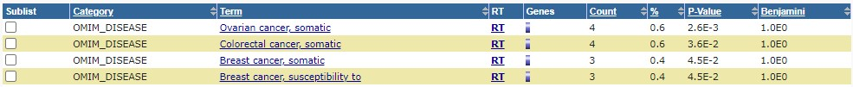
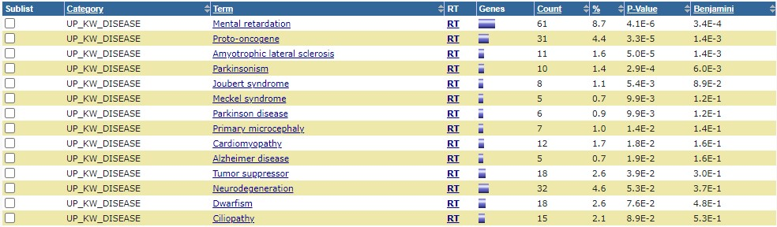
Homo Sapiens 4# Disease (Cont.) OMIM_DISEASE & UP_KW_DISEASE

Slide 29
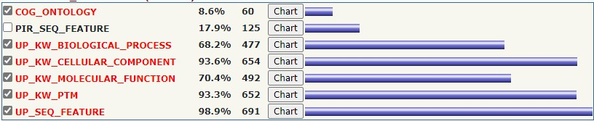
Homo Sapiens 5# Functional Annotations

Slide 30
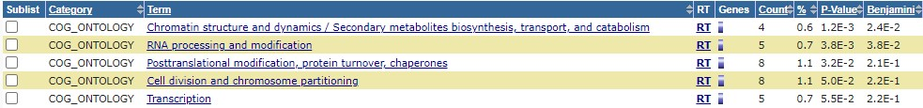
Homo Sapiens 5# Functional Annotations (Cont.) COG_ONTOLOGY

Slide 31
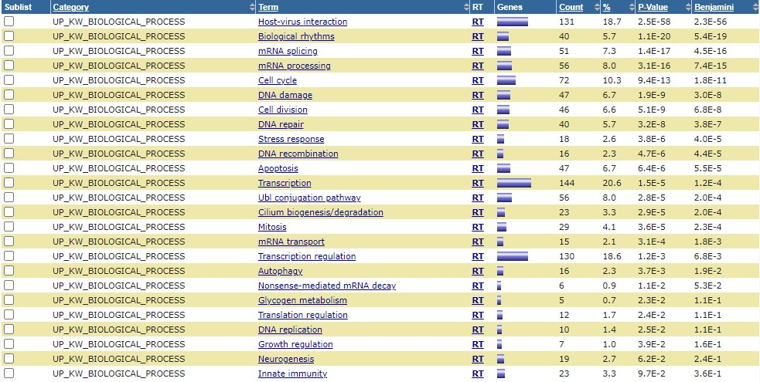
Homo Sapiens 5# Functional Annotations (Cont.) UP_KW_BIOLOGICAL_PROCESS

Slide 32
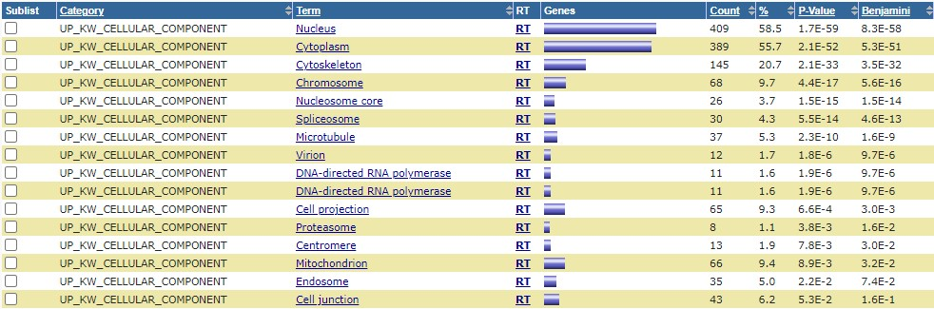
Homo Sapiens 5# Functional Annotations (Cont.) UP_KW_CELLULAR_COMPONENT

Slide 33
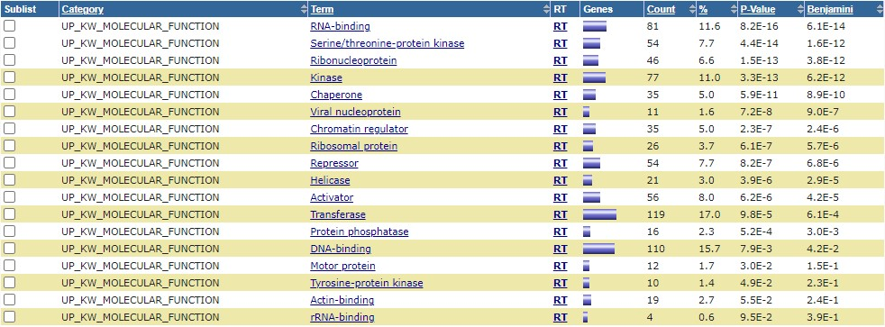
Homo Sapiens 5# Functional Annotations (Cont.) UP_KW_MOLECULAR_FUNCTION

Slide 34
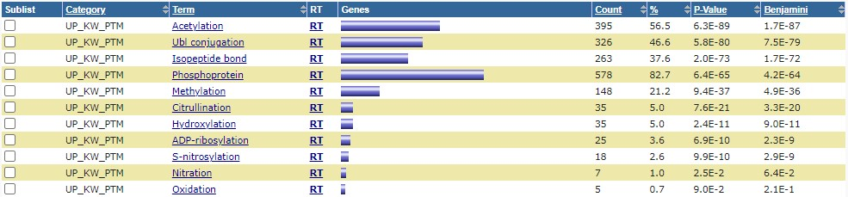
Homo Sapiens 5# Functional Annotations (Cont.) UP_KW_PTM

Slide 35
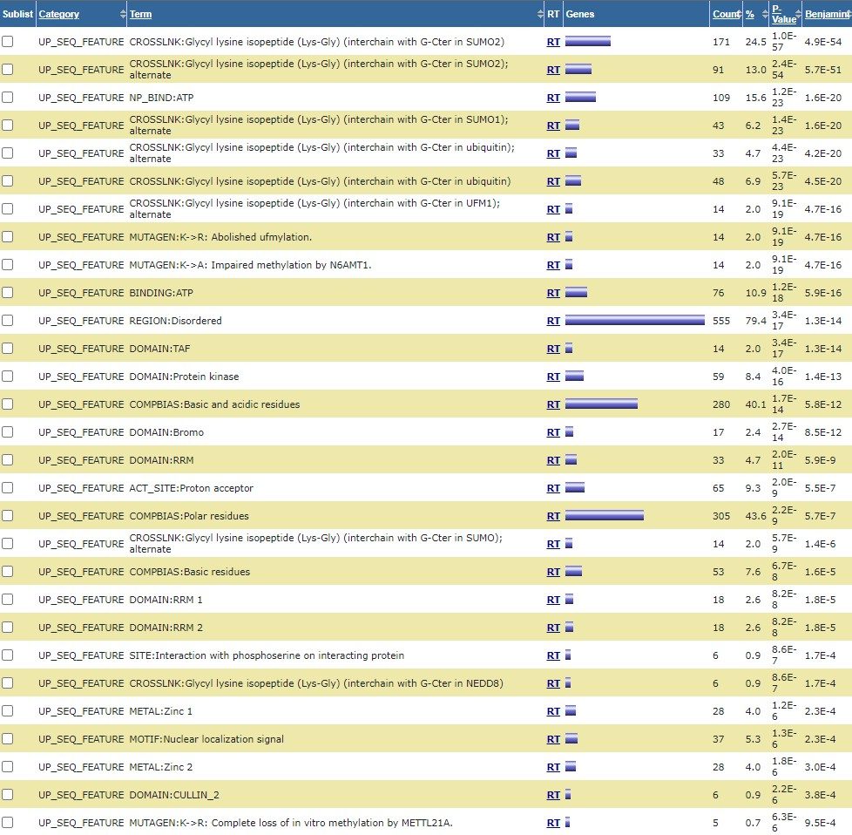
Homo Sapiens 5# Functional Annotations (Cont.) UP_SEQ_FEATURE

Slide 36
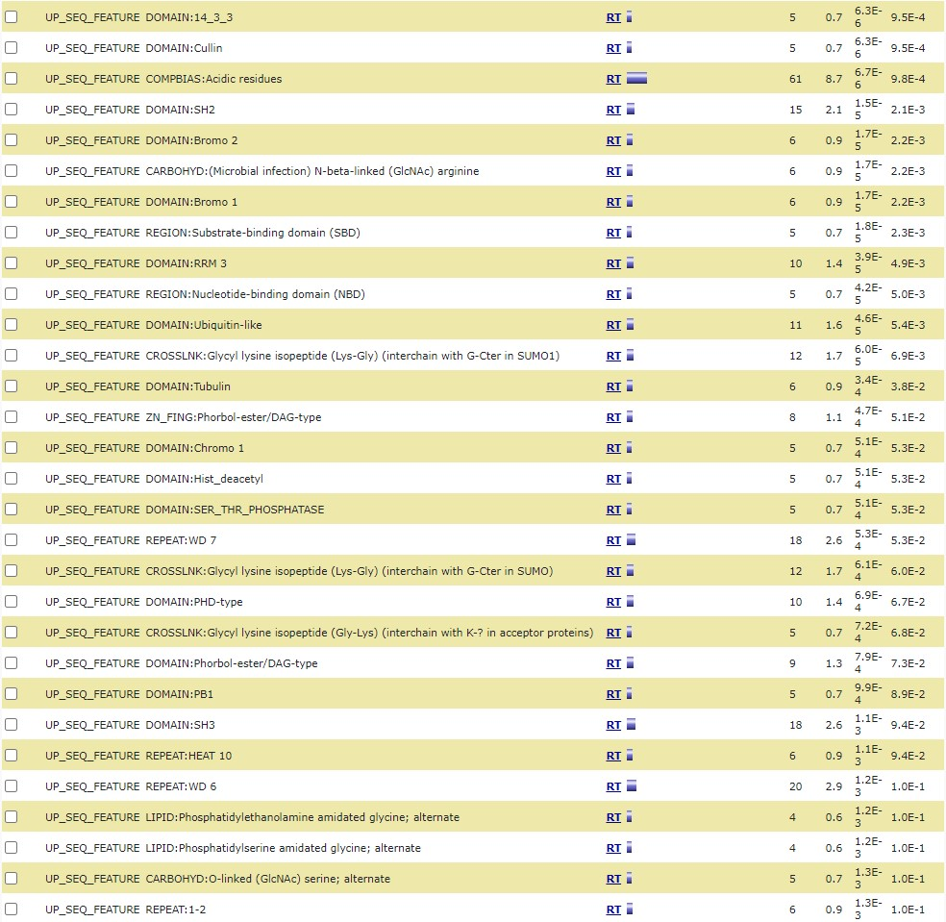
Homo Sapiens 5# Functional Annotations (Cont.) UP_SEQ_FEATURE (Cont.)

Slide 37
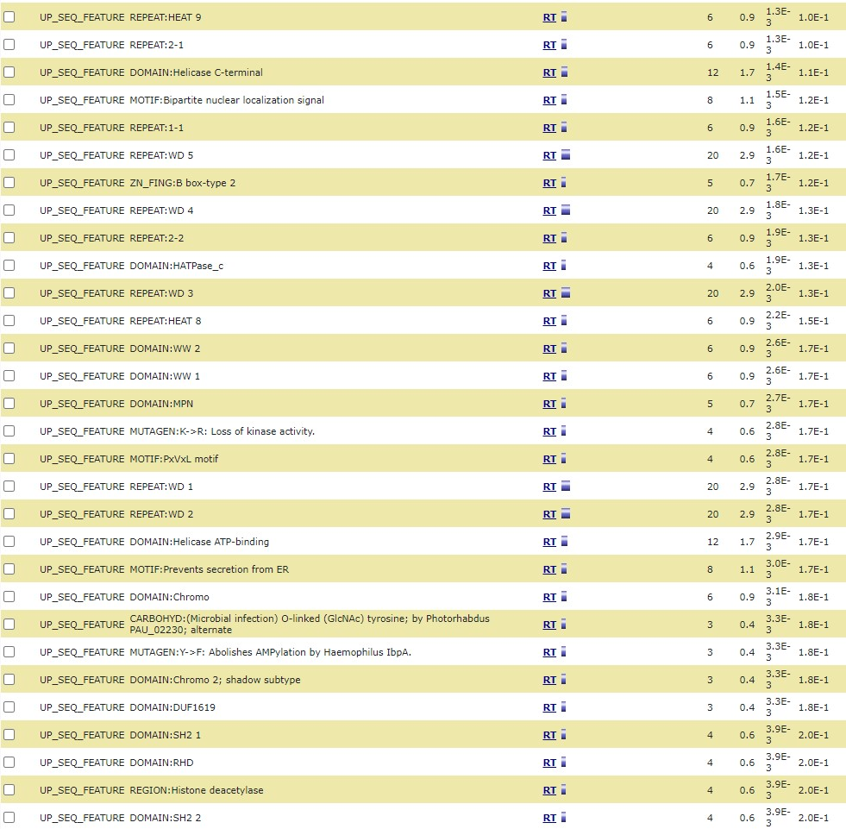
Homo Sapiens 5# Functional Annotations (Cont.) UP_SEQ_FEATURE (Cont.)

Slide 38
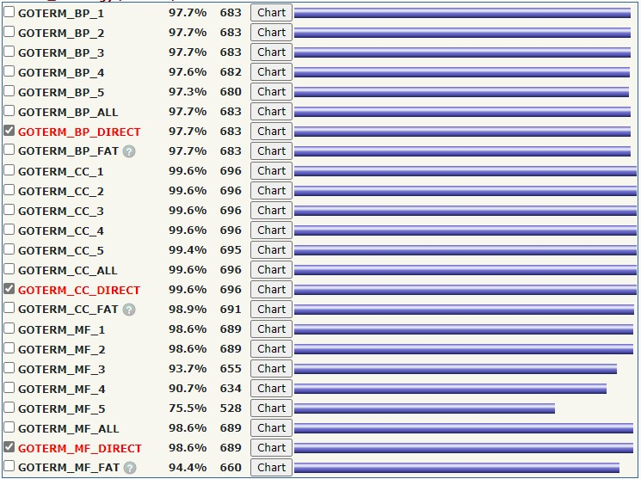
Homo Sapiens 6# Gene Ontology

Slide 39
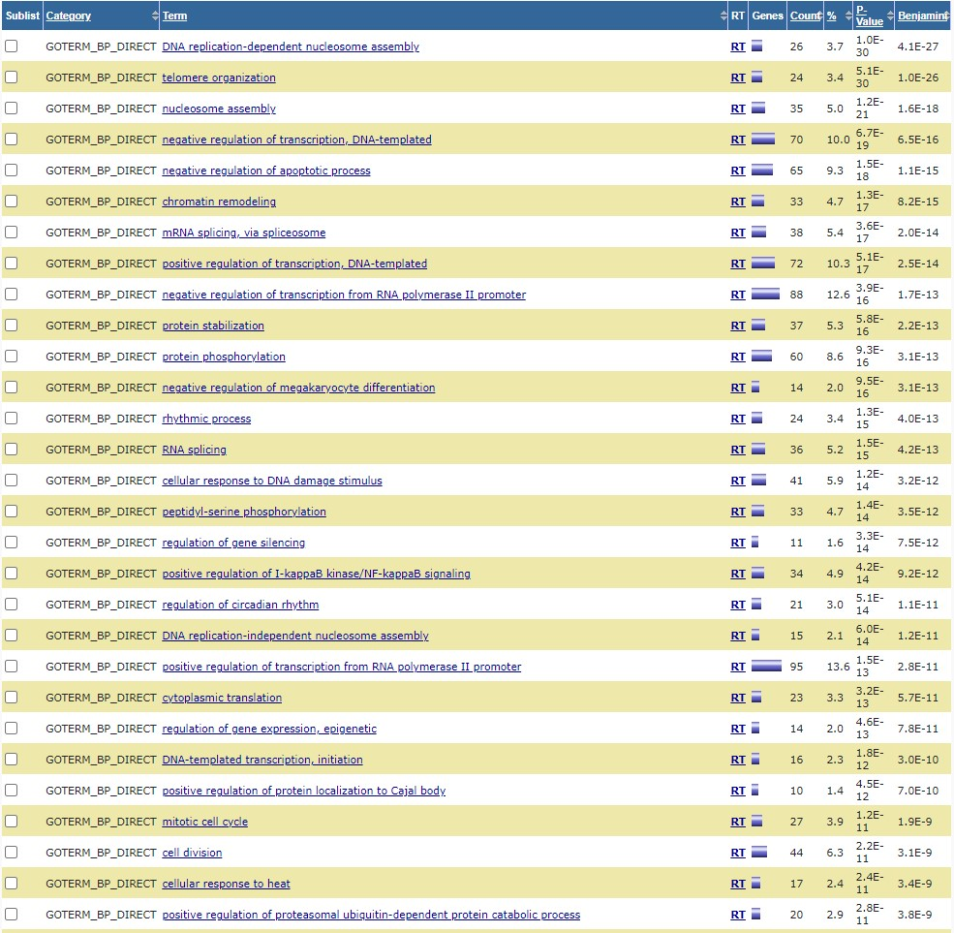
Homo Sapiens 6# Gene Ontology (Cont.) GOTERM_BP_DIRECT

Slide 40
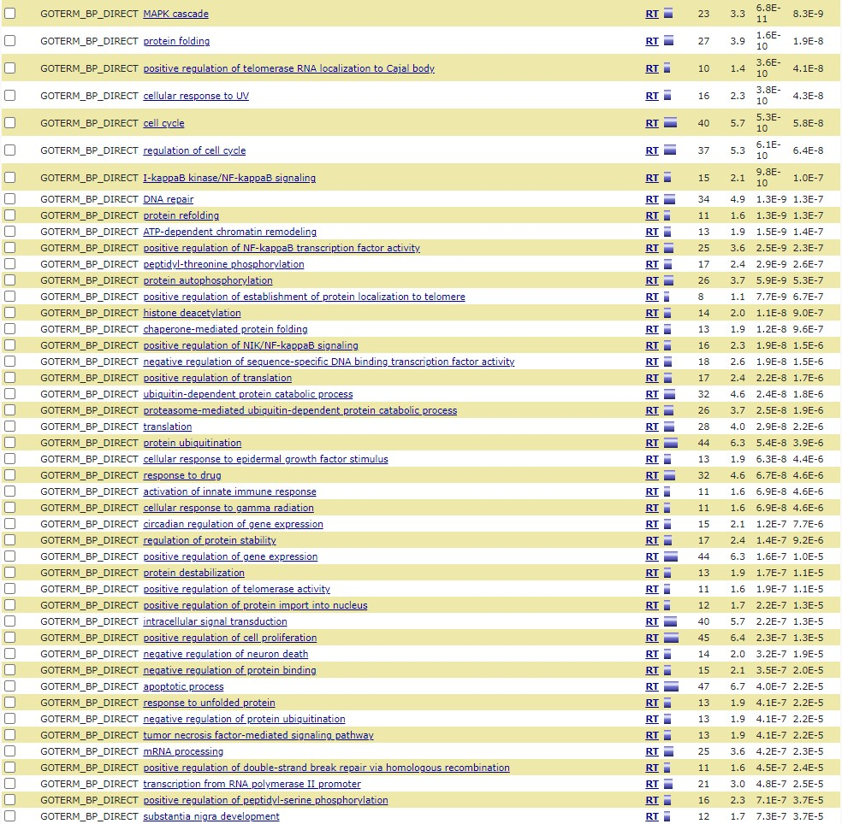
Homo Sapiens 6# Gene Ontology (Cont.) GOTERM_BP_DIRECT (Cont.)

Slide 41
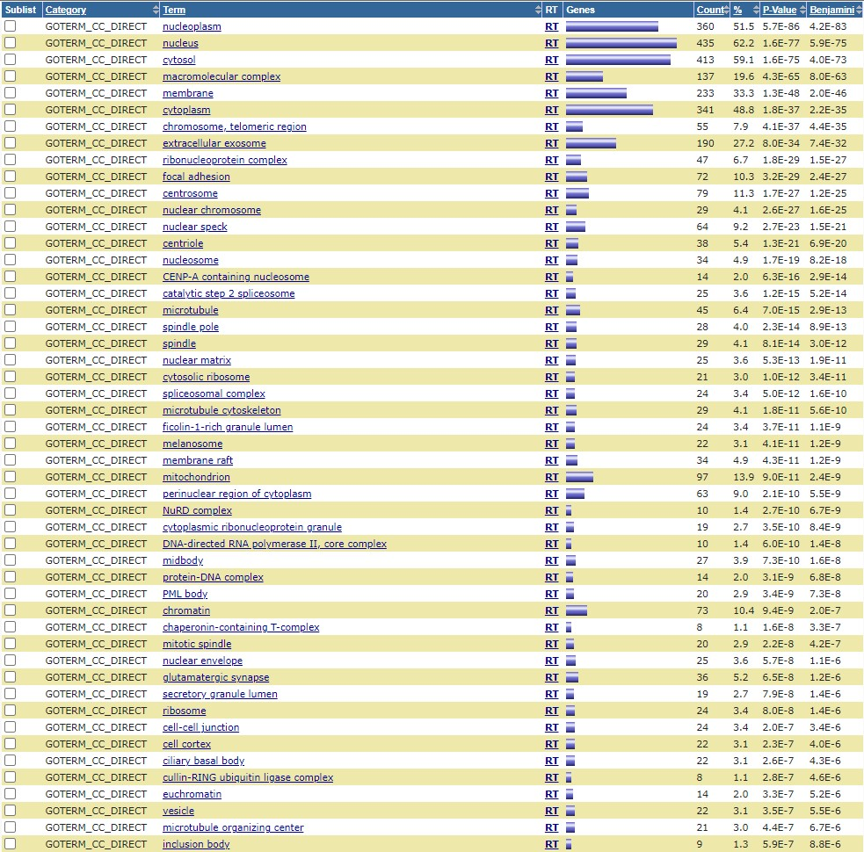
Homo Sapiens 6# Gene Ontology (Cont.) GOTERM_CC_DIRECT

Slide 42
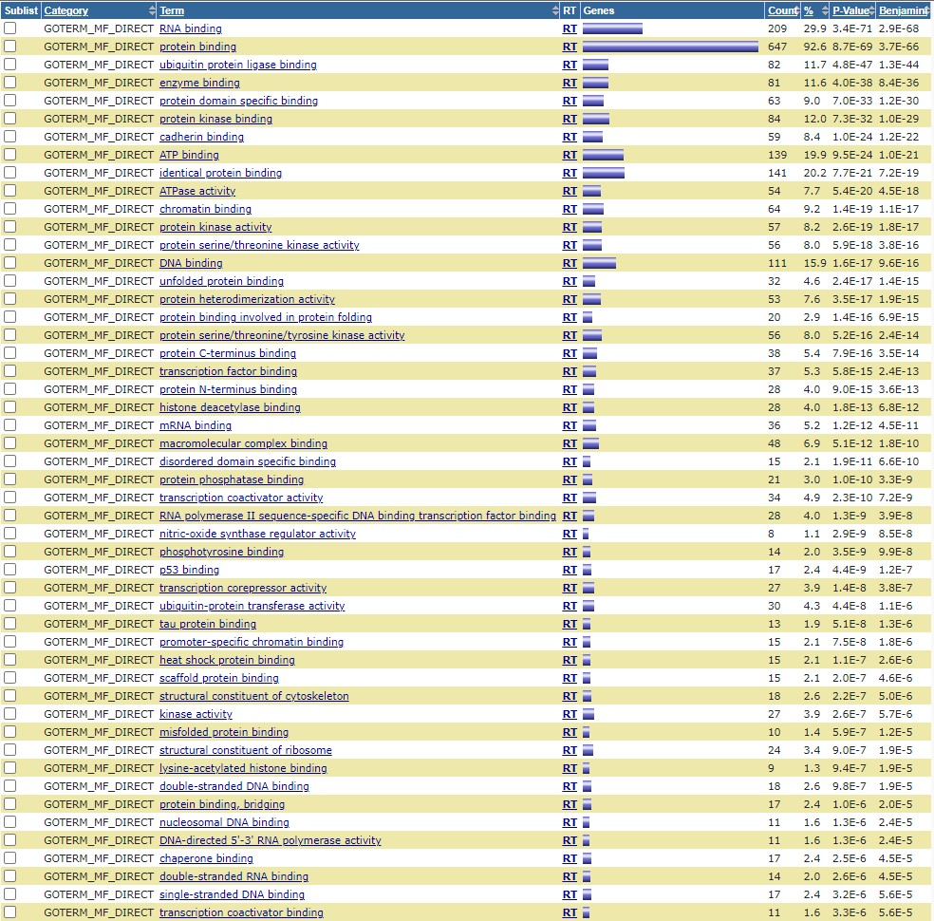
Homo Sapiens 6# Gene Ontology (Cont.) GOTERM_MF_DIRECT

Slide 43
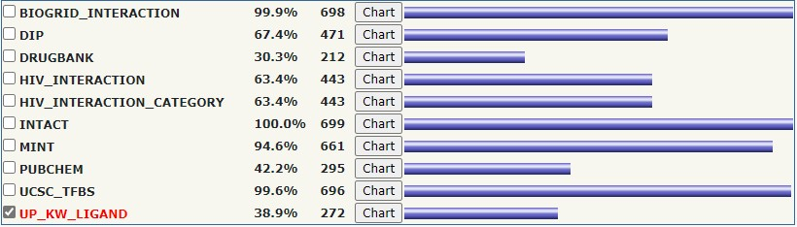
Homo Sapiens 7# Interactions

Slide 44
Homo Sapiens 7# Interactions (Cont.) UP_KW_LIGAND

Slide 45
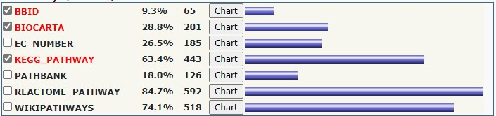
Homo Sapiens 8# Pathways

Slide 46
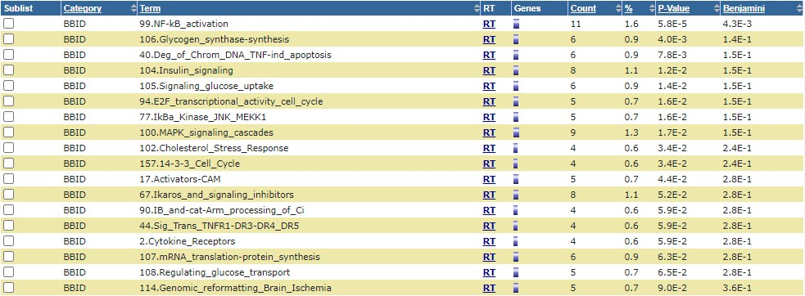
Homo Sapiens 8# Pathways (Cont.) BBID

Slide 47
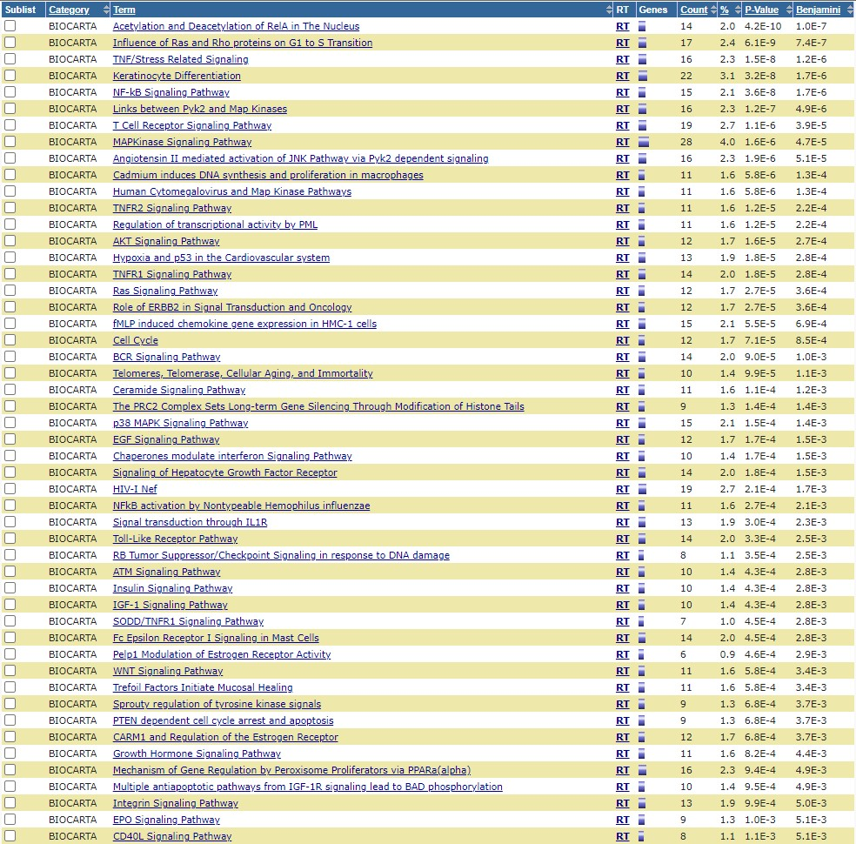
Homo Sapiens 8# Pathways (Cont.) BIOCARTA

Slide 48
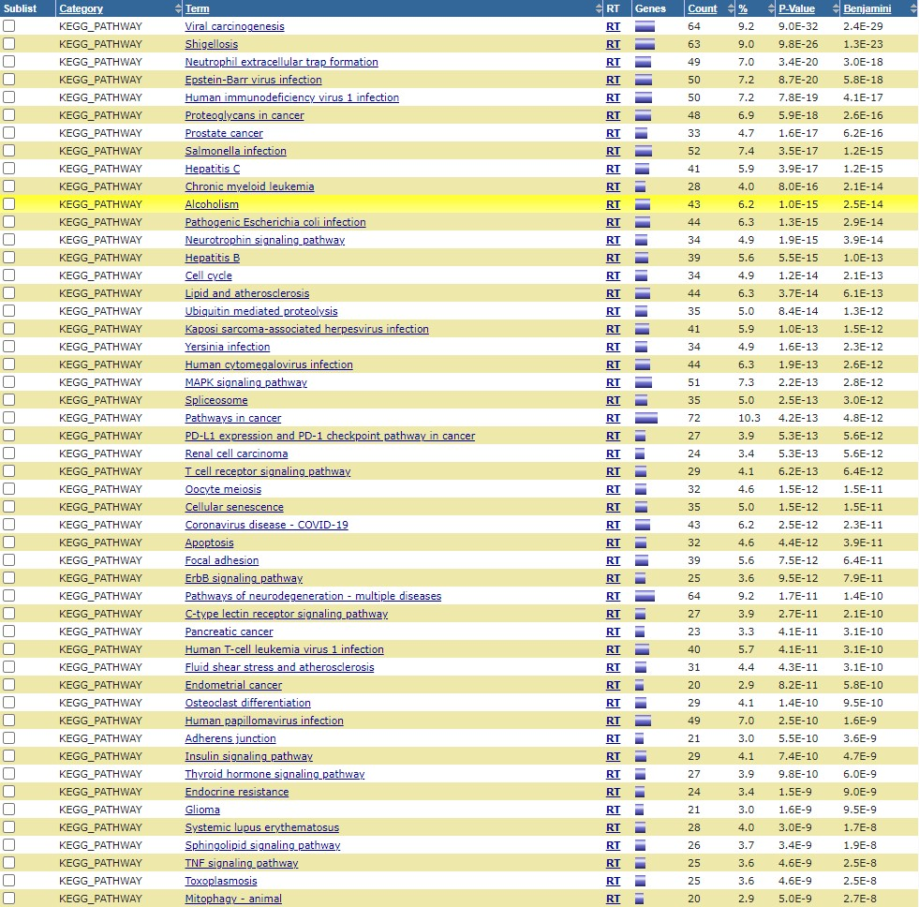
Homo Sapiens 8# Pathways (Cont.) KEGG_PATHWAY

Slide 49
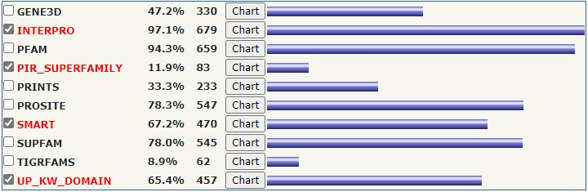
Homo Sapiens 9# Protein Domains

Slide 50
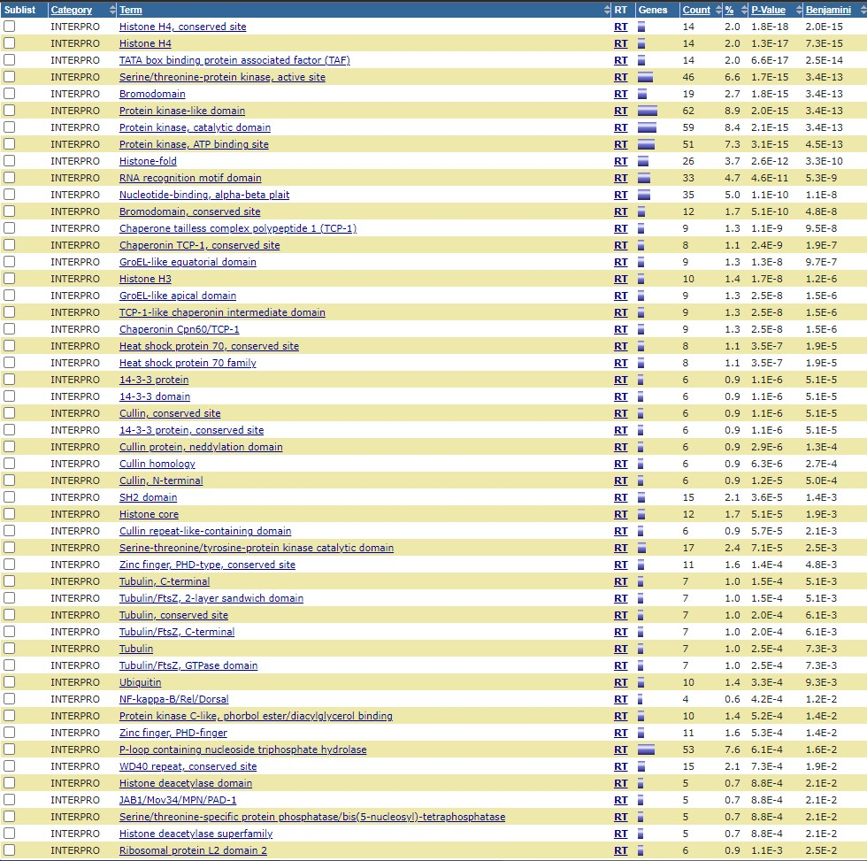
Homo Sapiens 9# Protein Domains (Cont.) INTERPRO

Slide 51
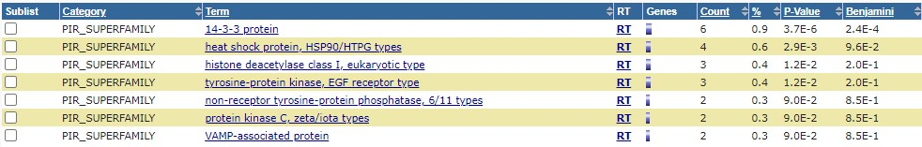
Homo Sapiens 9# Protein Domains (Cont.) PIR_SUPERFAMILY

Slide 52
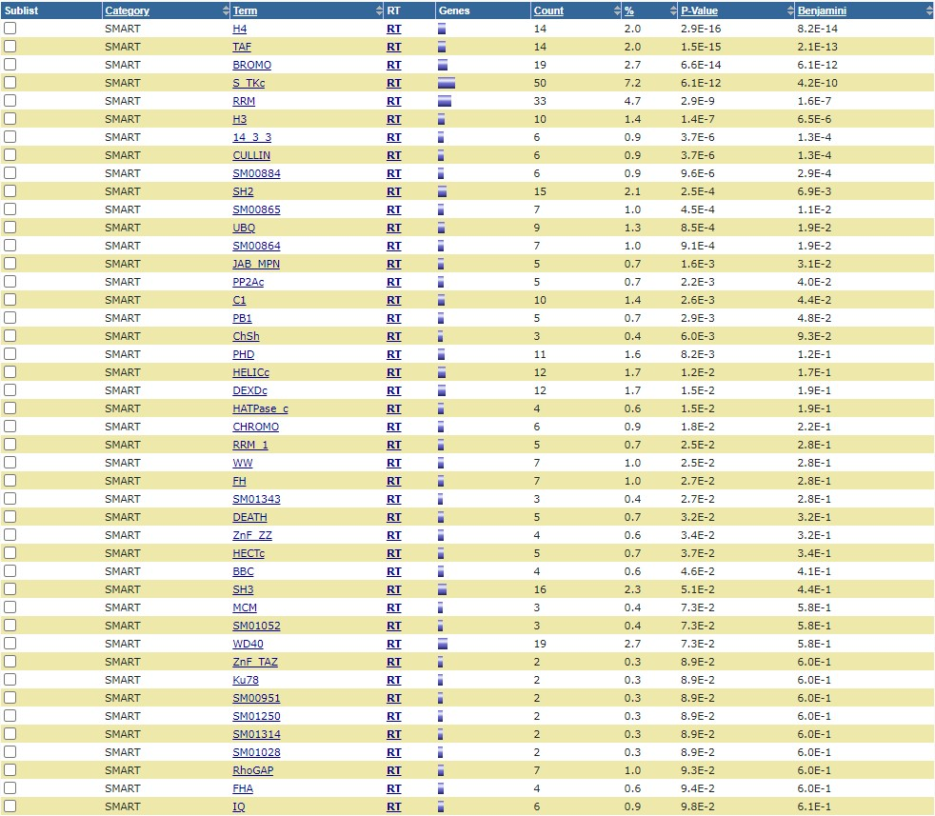
Homo Sapiens 9# Protein Domains (Cont.) SMART

Slide 53
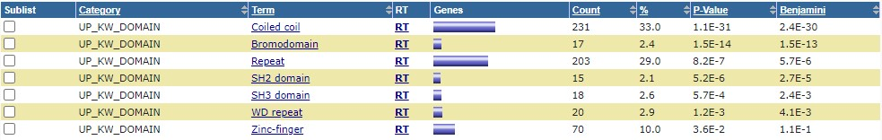
Homo Sapiens 9# Protein Domains (Cont.) UP_KW_DOMAIN

Slide 54
Mus Musculus

Slide 55
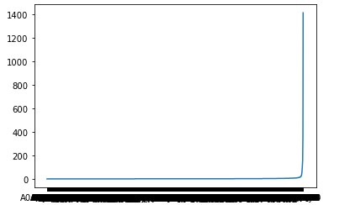
Mus Musculus 1# Degrees Plot

Slide 56
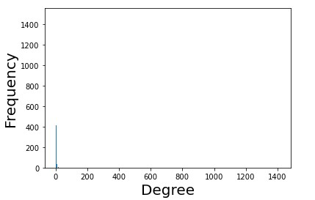
Mus Musculus 2# Degrees Count Plot

Slide 57


Mus Musculus 3# Degrees Distribution Plots

Slide 58

Mus Musculus 4# Functional Annotations

Slide 59

Mus Musculus 4# Functional Annotations (Cont.) COG_ONTOLOGY & UP_KW_BIOLOGICAL_PROCESS

Slide 60

Mus Musculus 4# Functional Annotations (Cont.) UP_KW_CELLULAR_COMPONENT

Slide 61

Mus Musculus 4# Functional Annotations (Cont.) UP_KW_MOLECULAR_FUNCTION

Slide 62

Mus Musculus 4# Functional Annotations (Cont.) UP_KW_PTM

Slide 63

Mus Musculus 4# Functional Annotations (Cont.) UP_SEQ_FEATURE

Slide 64

Mus Musculus 5# Gene Ontology

Slide 65

Mus Musculus 5# Gene Ontology (Cont.) GOTERM_BP_DIRECT

Slide 66

Mus Musculus 5# Gene Ontology (Cont.) GOTERM_CC_DIRECT

Slide 67

Mus Musculus 5# Gene Ontology (Cont.) GOTERM_MF_DIRECT

Slide 68

Mus Musculus 6# Interactions

Slide 69
Mus Musculus 6# Interactions (Cont.) UP_KW_LIGAND

Slide 70

Mus Musculus 7# Pathways

Slide 71

Mus Musculus 7# Pathways (Cont.) BIOCARTA

Slide 72

Mus Musculus 7# Pathways (Cont.) KEGG_PATHWAY

Slide 73

Mus Musculus 8# Protein Domains

Slide 74

Mus Musculus 8# Protein Domains (Cont.) INTERPRO

Slide 75

Mus Musculus 8# Protein Domains (Cont.) PIR_SUPERFAMILY

Slide 76

Mus Musculus 8# Protein Domains (Cont.) SMART

Slide 77

Mus Musculus 8# Protein Domains (Cont.) UP_KW_DOMAIN

